Slide 1
Defensive programming

Slide 2
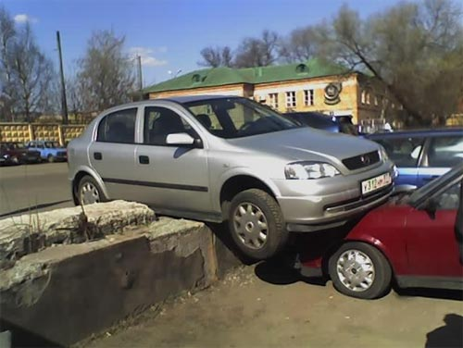
It’s like defensive driving

Slide 3
Why?
At many times you are unsure about the values of variables you will get.
Either because it is provided from external source or it is generated by some complex system with random component.

Slide 4
So what to look for?
At critical points think of accepted ranges of variables.
For both experimental and simulated data this is a very good exercise that lets you understand the problem you are working on.

Slide 5
What to do?
There are two possible outcomes if a variable gets an unexpected value. You can either:
Replace it with a different one
Terminate the whole program

Slide 6
Exceptions
Use when you know how to handle the “unexpected” for:
Alternative solution to solving the same issue
Maintaining an error log

Slide 7
Exceptions syntax
MATLAB
try
throw(MException(‘foo‘));
catch ME
ME.stack
ME.message
end

Slide 8
Exceptions syntax
rethrow(ME);

Slide 9
Exceptions syntax
Python
try:
except IOError:
...
except ValueError:
...
except:
...
finally:
...

Slide 10
Exceptions syntax
raise IOError
raise

Slide 11
Assertions
MATLAB:
assert(expression)
assert(expression, 'msgString‘)
Python:
assert expression, 'msgString‘

Slide 12
MATLAB extras
error
warning
pause or keyboard

Slide 13
Naming conventions

Slide 14
Loops
i,j,k ...
Try something more meaningful to avoid confusion
for i in range(5):
weights[i] +=5
for neuronIndex in range(5):
weights[neuronIndex] +=5

Slide 15
Be consistent
my_variable vs myVariable vs MyVariable
Does not really matter as long as you are consitent

Slide 16
Temporary variables
Avoid tmp, temp etc.
Giving them sensible names does not cost too much but greatly improves readability

Slide 17
Names to avoid
Similar meaning
Similar names
Easily misspelled words
Numerals in names
L or l

Slide 18
Naming conventions in maths
i, j, k Array subscripts,loop counters
i, j √−1 with complex arithmetic
m, n End of a sequence, i = 1, . . . , n, number of rows (m) and columns (n) in a matrix
A, B generic matrix
x, y, z generic vectors

